Slide 1
Business & Government in the Network Age
Kevin Werbach
Associate Professor of Legal Studies
werbach@wharton.upenn.edu
February 2011

Slide 2
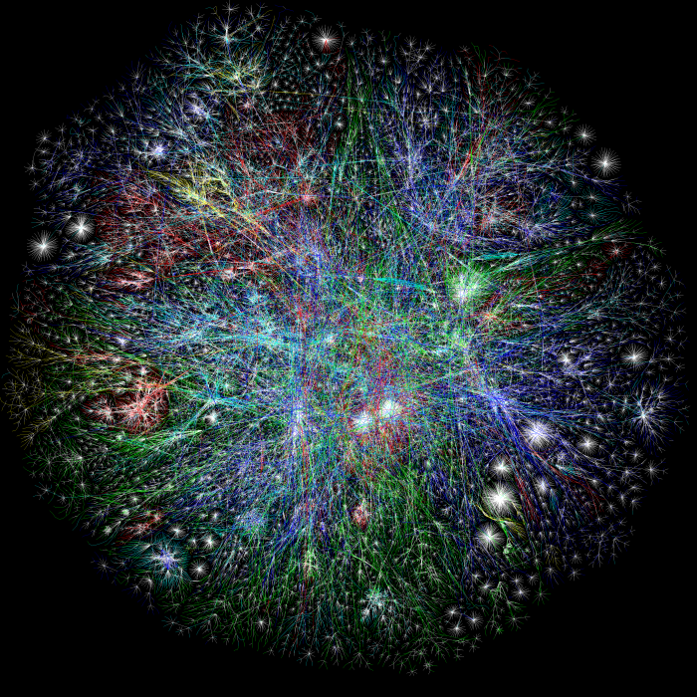
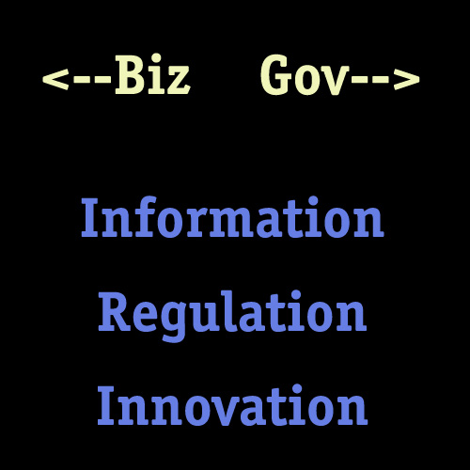
The Network Age
Everything is connected
Data, data, everywhere
Notes:
2 billion net users. 5 billion mobile phones. 500m on Facebook, Skype, QQ. How man of you are NOT on Facebook?

Slide 3
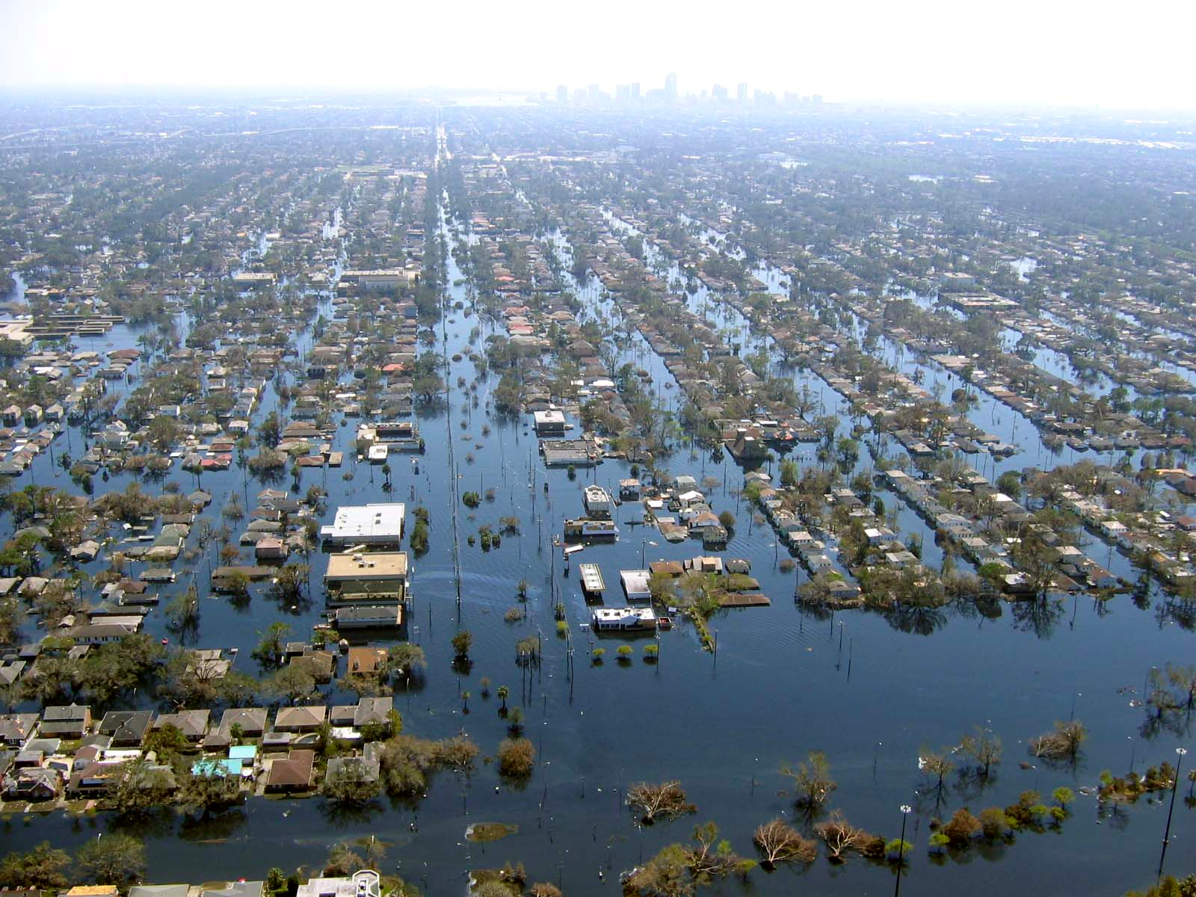
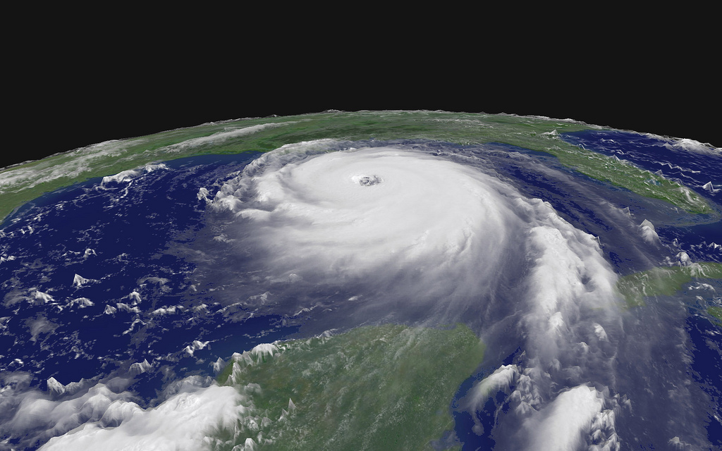
Information
Notes:
Information. Companies don’t know what they know. Social networking and connected devices give them new insights. Government as data pipe. Weather.com data comes from NOAA. GDP, CPI, Unemployment, GPS, broadband adoption, etc. – USG data collection. SPECTRUM DNS. Companies collect lots of real user data that doesn’t always feed into policy process. Privacy/security – how much information to share. Katrina – we can fail to make use of data.

Slide 4
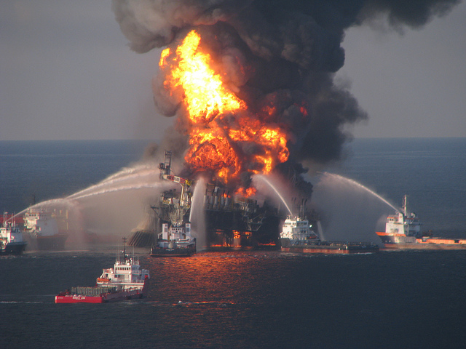
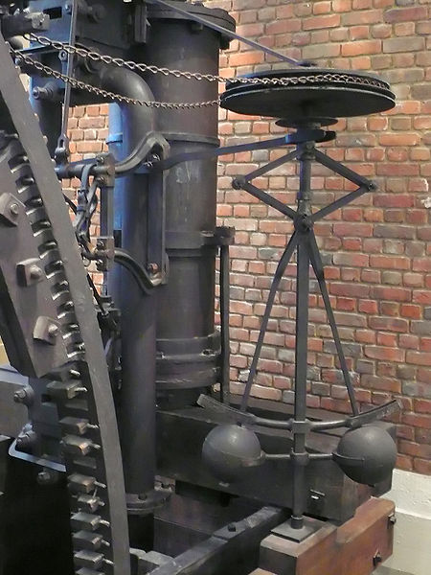
Regulation
De- Regulation
Notes:
Regulator – 1871 steam engine (centrifugal governor). Regulation is endogenous. Financial crisis as well as climate change show need for internal brakes on the system. CLICK – BP oil spill shows what happens when regulation fails. Build in regulation of relationships among network providers via technical terms of interconnection – Network Utility. Business can do the same via APIs and how they relate to the outside.

Slide 5

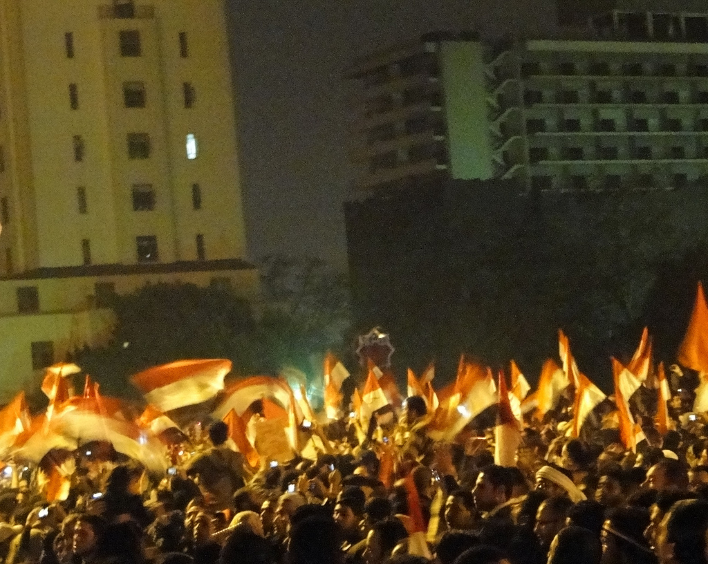
E V O L U T I O N
R E V O L U T I O N !
Innovation?
Notes:
Every company wants to be innovative. But, not one knows what it means. And innovation can destroy you. Compare: Apple, Nokia, Borders. Also, innovation needs foundations. Internet via DARPA, health care via funded research, markets in education and energy via government setting up conditions.
Twitter and Facebook did not cause the flash revolutions that are breaking out across the Middle East, but they are a powerful illustration of what can happen when everyone is connected .

Slide 6
For More…
werbach@wharton.upenn.edu
Twitter: @kwerb
http://werbach.com/writings/

Slide 7
Photo Attributions
Peacock Maps
NOAA
http://commons.wikimedia.org/wiki/File:Katrina_Storm.jpg
Mirko Junge
http://commons.wikimedia.org/wiki/File:Boulton_and_Watt_centrifugal_governor-MJ.jpg
US Coast Guard
http://commons.wikimedia.org/wiki/File:Deepwater_Horizon_offshore_drilling_unit_on_fire.jpg
Mykl Roventine
http://www.flickr.com/photos/myklroventine/3689364622/
Ramy Raoof
http://www.flickr.com/photos/ramyraoof/5436953472/

